Slide 1
Likes and dislikes
Year 3

Slide 2
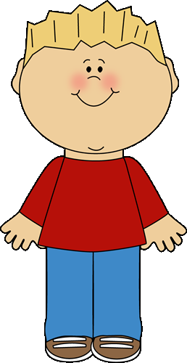

I like pizza.

Slide 3
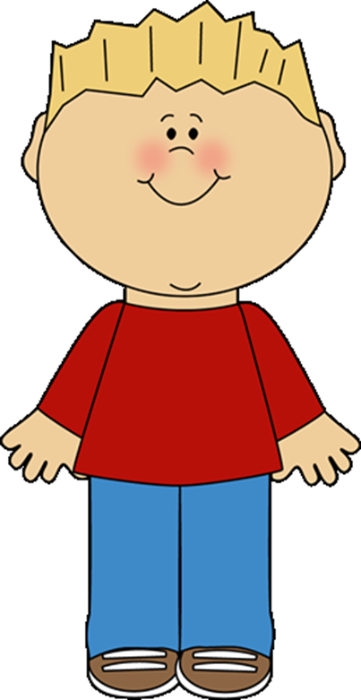
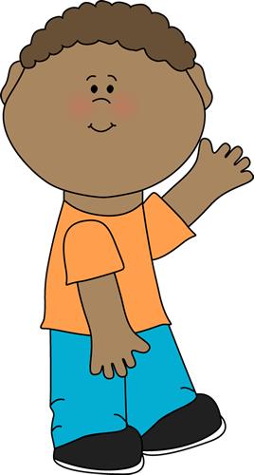

He likes pizza.

Slide 4
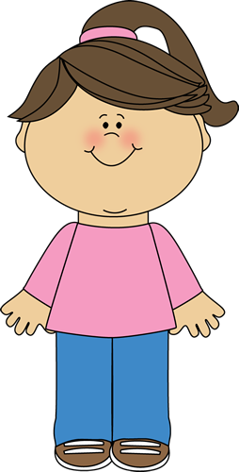
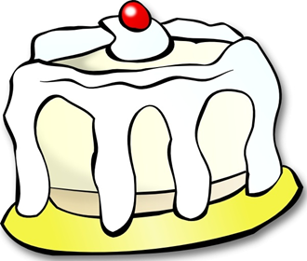
I like cake.

Slide 5

She likes cake.

Slide 6
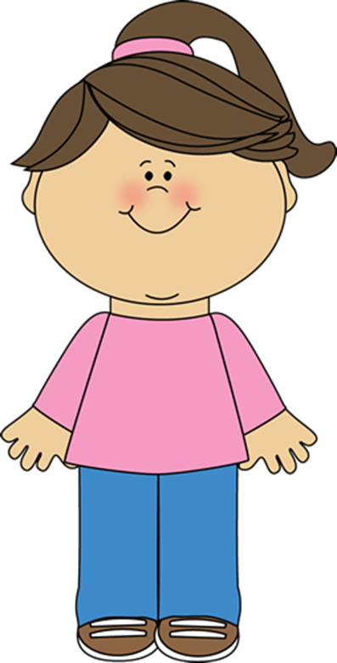

I like chips.
I like chips, too.

Slide 7

They like chips.

Slide 8

I don’t like coffee.

Slide 9
He doesn’t like coffee.

Slide 10



I don’t like milk.

Slide 11
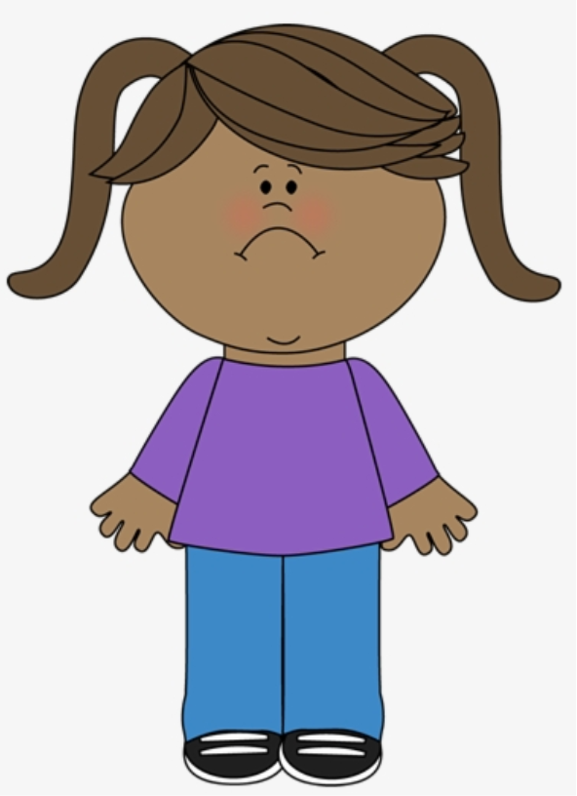

She doesn’t like milk.

Slide 12
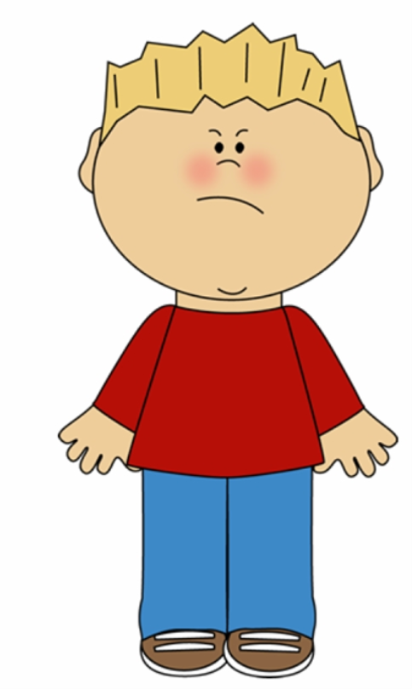

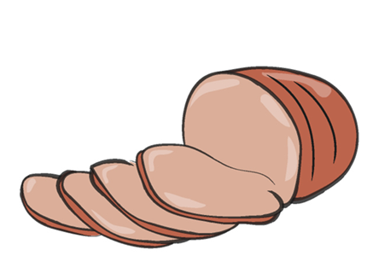
I don’t like ham.
I don’t like ham.

Slide 13



They don’t like ham.

Slide 14
He likes | She likes | They like
He doesn’t like | She doesn’t like | They don’t like

Slide 15
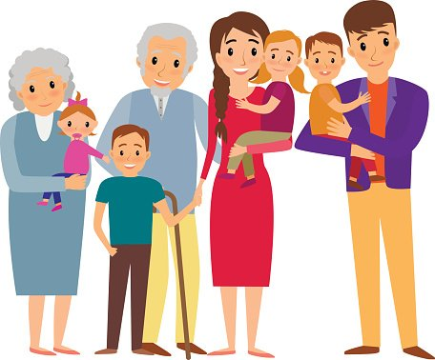
Ask someone from your family and find out!
Do you like apples?
Do you like eggs?
Do you like tea?
Do you like cheese?

Slide 16
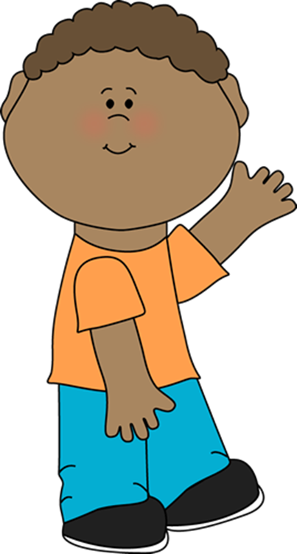

Now write down what he/she likes and send your work to your teacher!
Mum likes...Mum doesn’t like…
Dad likes…Dad doesn’t like…
My brother likes…My brother doesn’t like…
Dad likes…Dad doesn’t like…

Slide 17


You can also record yourself while reading what you wrote!
Mum likes...Mum doesn’t like…
Dad likes…Dad doesn’t like…
My brother likes…My brother doesn’t like…
Dad likes…Dad doesn’t like…
Press here to listen to an example!

Slide 18
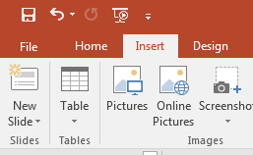
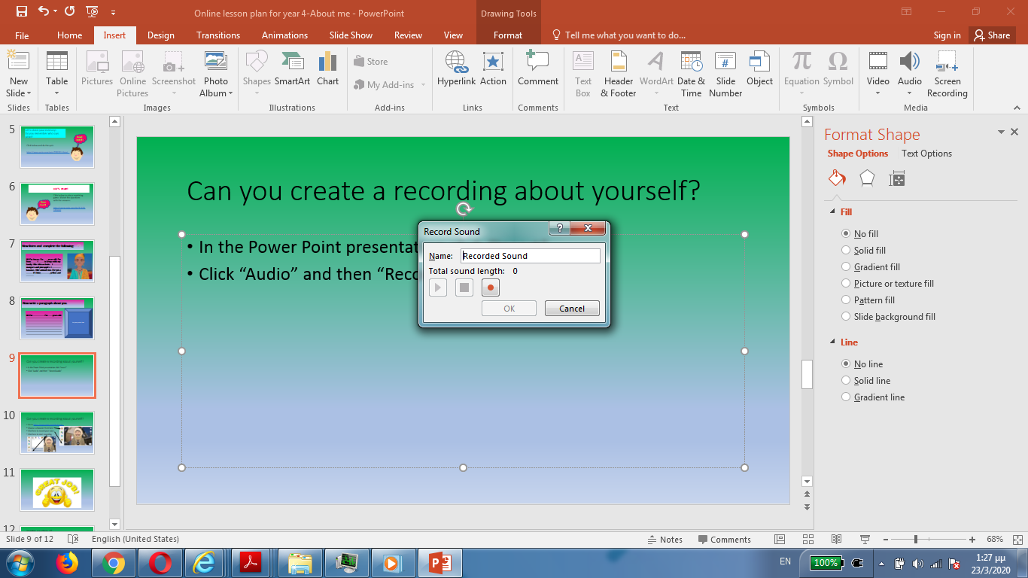
Can you create a recording about yourself?
In the Power Point presentation click “Insert”
Click “Audio” and then “Record Audio”
You will see this
Write your name and press
Start speaking.

Slide 19
Try this game!
Good luck!
https://www.quia.com/rr/1407329.html

Slide 20
Play this game!
Good luck!
https://www.quia.com/pop/745601.html?AP_rand=238475945

Slide 21

Put the words in the right order!
https://wordwall.net/resource/1310814/verb-like

Slide 22

Try these games, too!
Have fun!
https://learnenglishkids.britishcouncil.org/grammar-practice/and-dont

Slide 23
Images of courtesy
https://clipartart.com/
https://wikiclipart.com/
Presentation designed by the English Curriculum Development team,
Cyprus Ministry of Education and Culture

