Slide 1
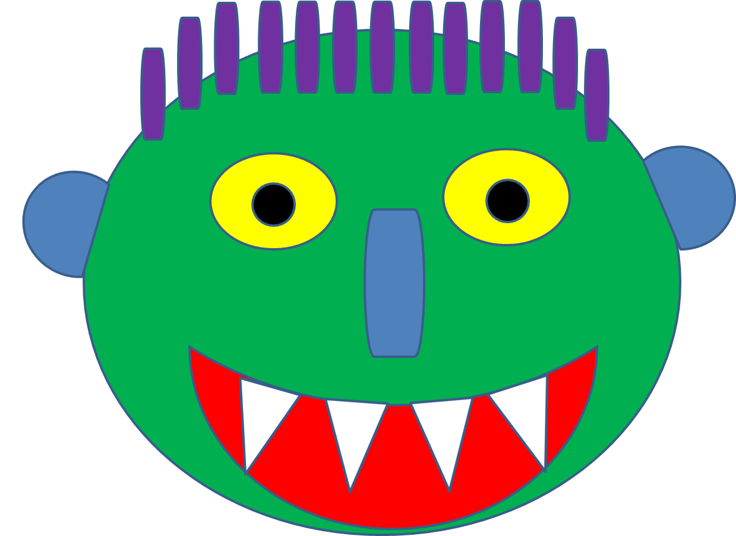
Story by Ed Emberley

Slide 2
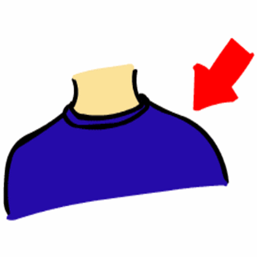
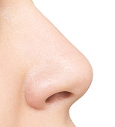
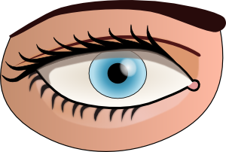
Let’s remember the body parts

Slide 3
Listen point and say

Slide 5
Say the words like a robot!

Slide 6
Say the words angrily!

Slide 7
Let’s play…

Slide 9
Let’s listen to a story!
https://www.youtube.com/watch?v=rPmLZLp-oec

Slide 10
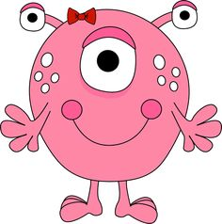
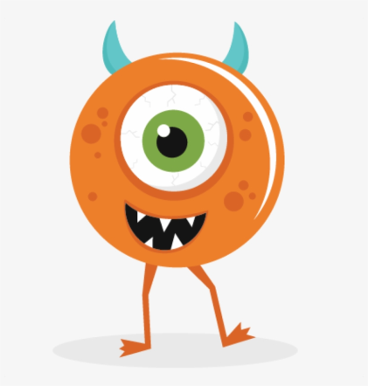
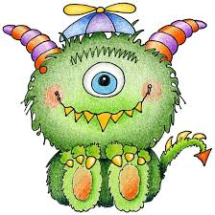
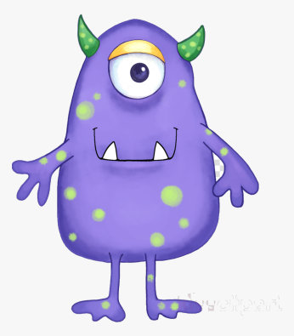
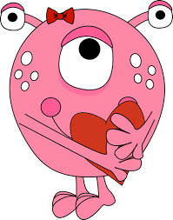
Let’s play!
https://matchthememory.com/matchingmonsters

Slide 11
Open your books on page 17.

Slide 13
Good job!

