Slide 1
Around the world in 80 minutes

Slide 2
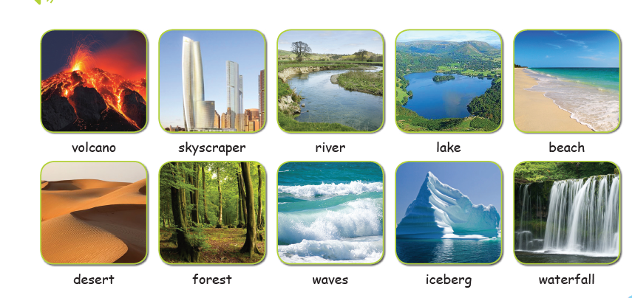
Let’s remember these:

Slide 3

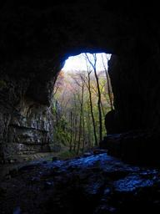
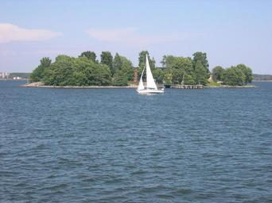
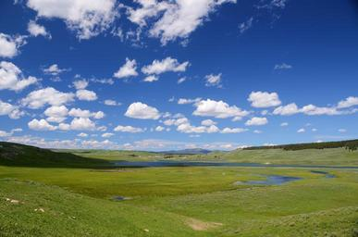
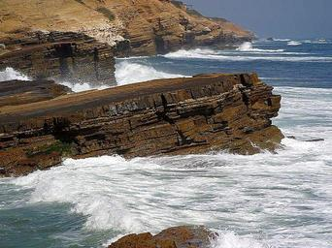
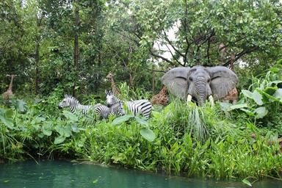
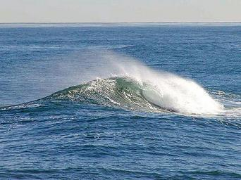
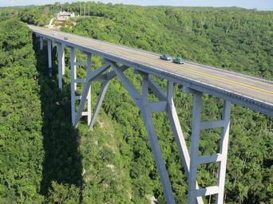
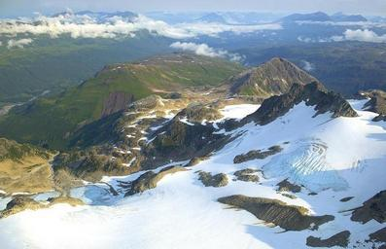
And some new words. Listen and repeat.
cave
island
valley
cliff
jungle
ocean
mountain
bridge

Slide 4
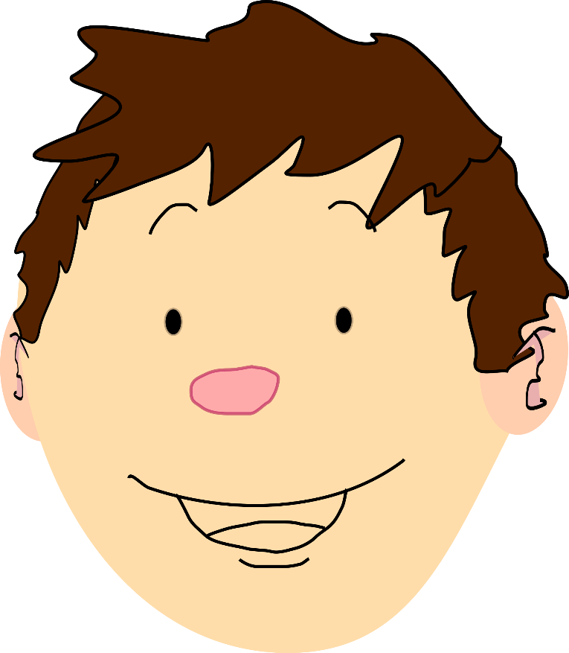
Now LET’S PLAY!
Let’s play a memory game!
https://www.eslgamesplus.com/nature-vocabulary-memory-game-for-esl-practice/
Have fun!!!
Now play this matching game with more words:
http://www.quia.com/jg/3115324.html

Slide 5
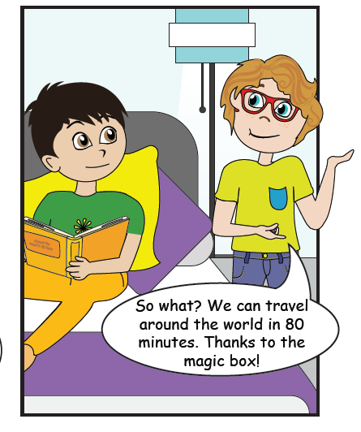
But Jamie has other plans……
Minas is reading a story about a man who travelled around the world in 80 days.

Slide 6
Minas and Jamie, decided to travel around the world in 80 minutes!
Let’s find out about Minas’ and Jamie’s trip.

Slide 7
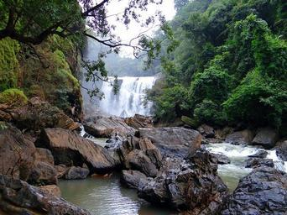
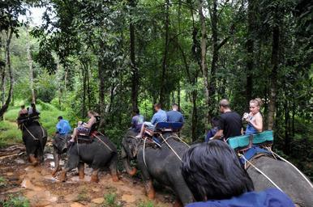
India
Minas and Jamie first went to India. The Magic Box took them to a jungle in India. They saw huge trees, big and small rivers, beautiful waterfalls and many wild animals. They also saw big caves but they were very scared to go inside. Guess what! They went through the jungle on elephants.
Click on the following link and find 5 animals that Minas and Jamie saw in the Indian Jungle. Write them in your exercise book.
https://greenglobaltravel.com/indian-animals-indian-wildlife-species/

Slide 8
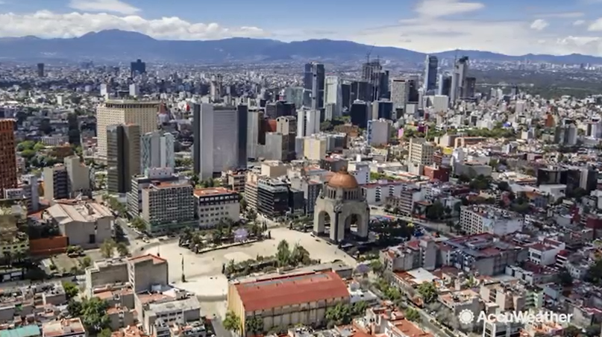
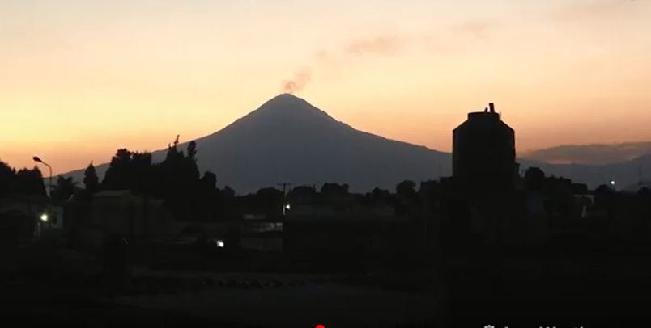
Mexico
Their second stop was Mexico. Jamie remembered the Escamoles that he tried last year. This year they also tried Fajitas and Tacos. They also saw a mountain with a volcano in Mexico. It was really scary because there was smoke coming out of it.
Click on the following link, watch the video and find 5 countries with the most dangerous volcanoes. Write them in your exercise book.
https://www.youtube.com/watch?v=uObhNE-YPa4

Slide 9
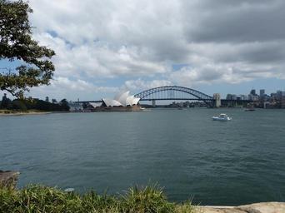
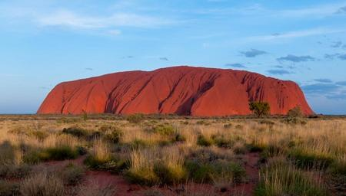
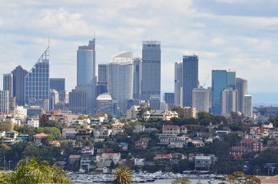
Australia
Their next stop was Australia. Australia is a very big country. It is also an island. It is between the Indian and the Pacific oceans. Minas and Jamie wanted to see so many things in Australia. They wanted to see the kangaroos, the big deserts, the valleys with the farms, the cities with the skyscrapers, the beaches with the big waves, the famous bridge in Sydney …But…
Click on the following link and find 3 big cities in Australia. Write them in your exercise book.
https://www.kids-world-travel-guide.com/australia-facts.html
What do you think happened?

Slide 10
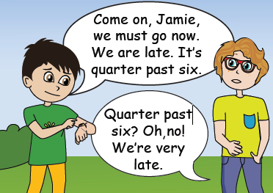
But…
Oh no! It’s time to go! Mum will be angry with me!
Well,I think it is very difficult to go around the world in 80 minutes. Especially when there are so many things to see and do.

Slide 11
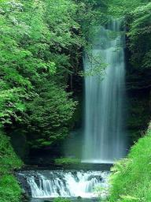
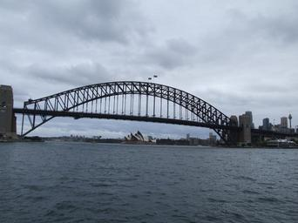
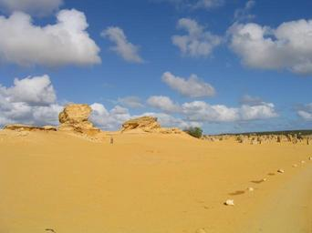
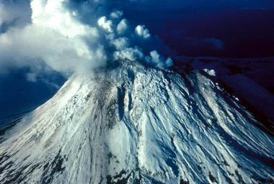
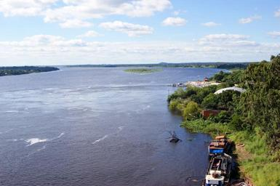
Where did Jamie and Minas see the following? Write the words next to the right country. Write them in your exercise book.
island
valley
jungle
ocean
cave
waterfall
mountain
skyscrapers
bridge
desert
volcano
river
Australia
India
Mexico

Slide 12
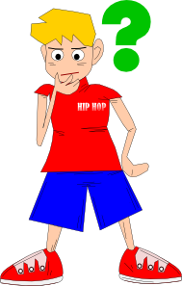
Let’s check your memory:
Click below and do the quiz.
http://www.quia.com/quiz/7670662.html

Slide 13
It’s your turn to travel around the world!
You have the Magic Box for 80 minutes.
Which country would you like to visit?
Write a paragraph about a place you visited.
Remember to:
Use words that you learnt today (e.g. mountain, volcano, valley, etc)
Write about things you did there.
Write about things you saw there.

Slide 14
Can you make a poster about a place that you visited?

Slide 15


Slide 16
Images courtesy of:
https://free-images.com/search/?q=mexico&cat=st
https://www.youtube.com/watch?v=uObhNE-YPa4
Presentation designed by the English Curriculum Development team,
Cyprus Ministry of Education, Culture, Sports and Youth

