Slide 1
School
Year 5

Slide 2
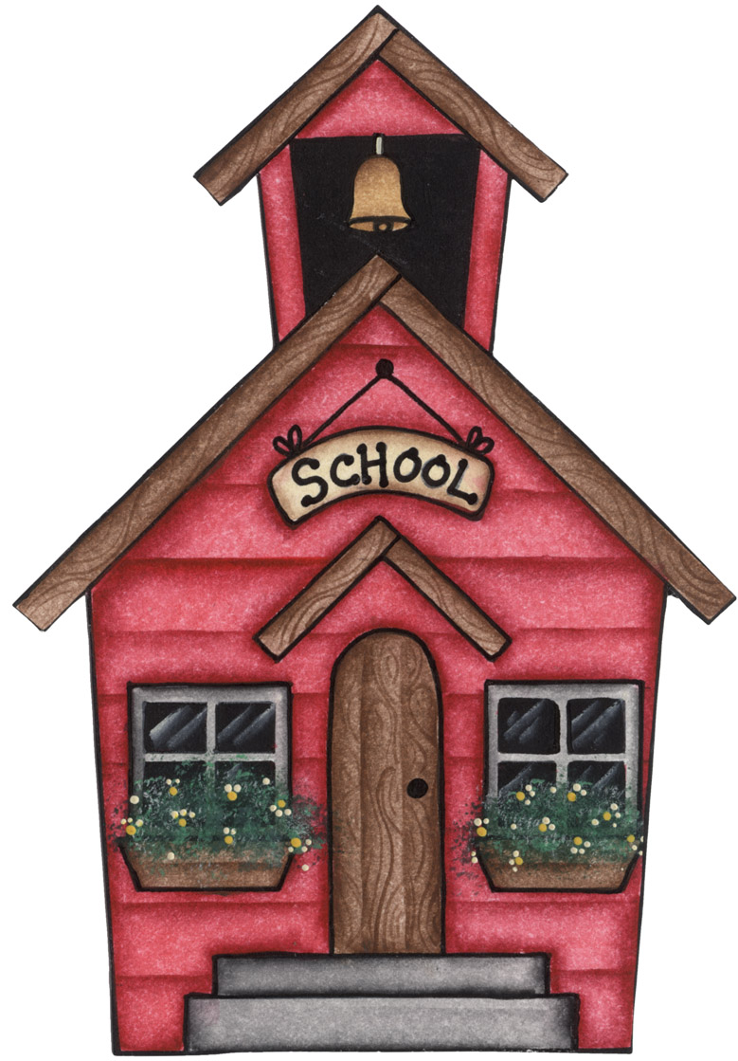
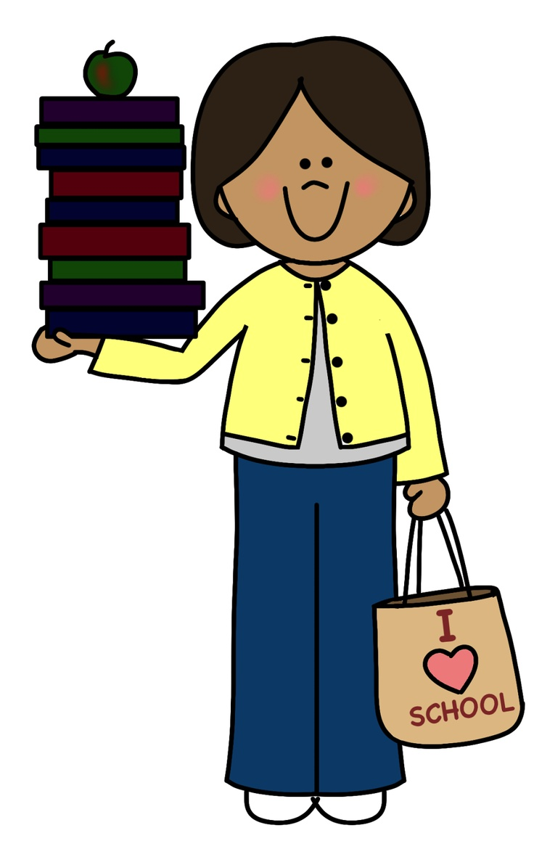

Time for school!
Are you ready? Let’s go!

Slide 3

Greek
ΑαΒβΓγ

Slide 4
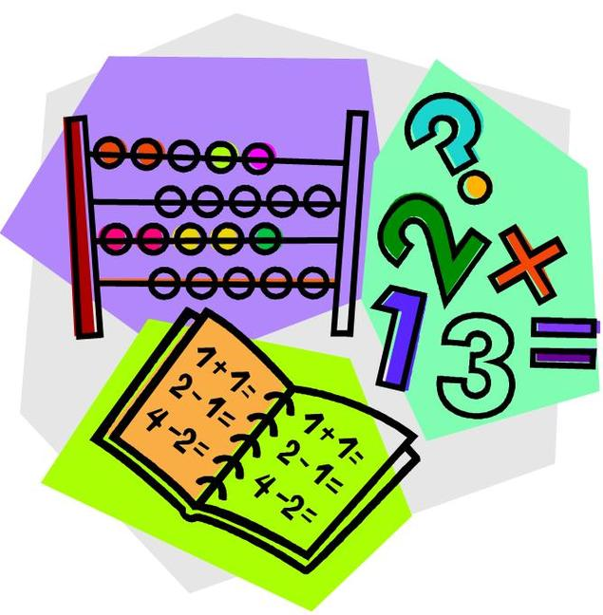
Maths

Slide 5

English

Slide 6
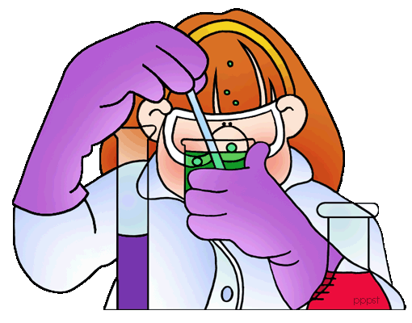
Science

Slide 7

History

Slide 8
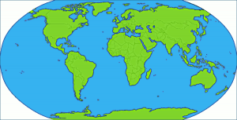
Geography

Slide 9
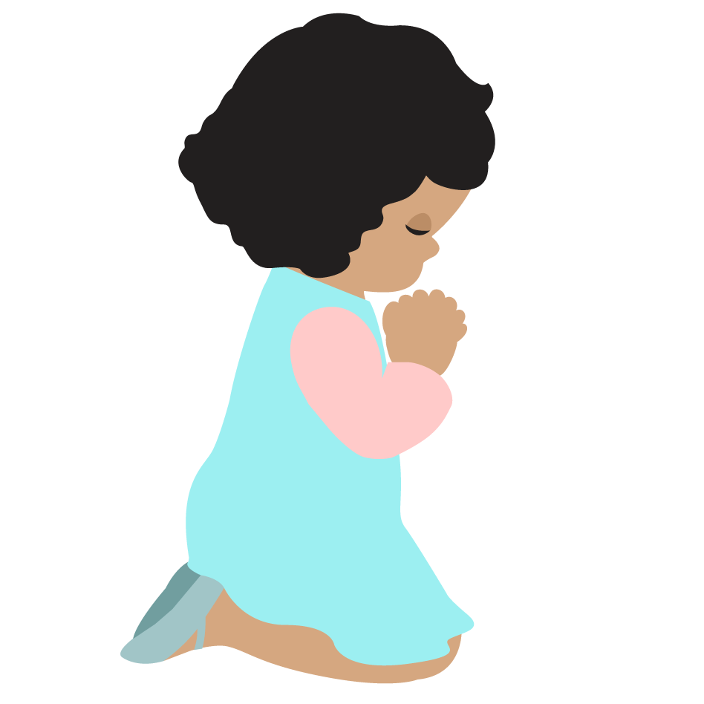
Religious Education

Slide 10

Art

Slide 11

Music

Slide 12
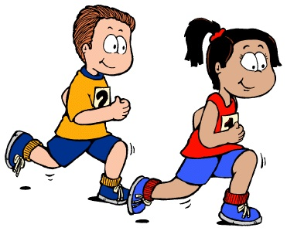
Physical Education

Slide 13




Design and technology

Slide 14
Play these games and check if you learnt all the school subjects!
https://www.eslgamesplus.com/school-vocabulary-game-practice-school-supplies-subjects-school-tools-and-actions/
https://learnenglishkids.britishcouncil.org/word-games/school-subjects
https://www.quia.com/pop/746401.html?AP_rand=45448991

Slide 15
Now, try to find the school subjects in this word search!
Good luck children!
https://wordwall.net/resource/1360490/school-subjects

Slide 16
Take a look at
Minas’ timetable!
MONDAY | TUESDAY | WEDNESDAY | THURSDAY | FRIDAY
GREEK | MATHS | GREEK | MATHS | GREEK
GREEK | GREEK | GREEK | MATHS | GREEK
ART | DESIGN AND TECHNOLOGY | MUSIC | GREEK | PHYSICAL EDUCATION
ART | DESIGN AND TECHNOLOGY | MATHS | GREEK | MATHS
MATHS | ENGLISH | SCIENCE | ENVIRONMENTAL EDUCATION | GEOGRAPHY
PHYSICAL EDUCATION | RELIGIOUS EDUCATION | SCIENCE | ENGLISH | RELIGIOUS EDUCATION
HISTORY | GEOGRAPHY | PHYSICAL EDUCATION | HISTORY | MUSIC

Slide 17


We use:
Once if it happens one time.
Twice if it happens two times.
Then:
Three times,
four times,
and so on.

Slide 18
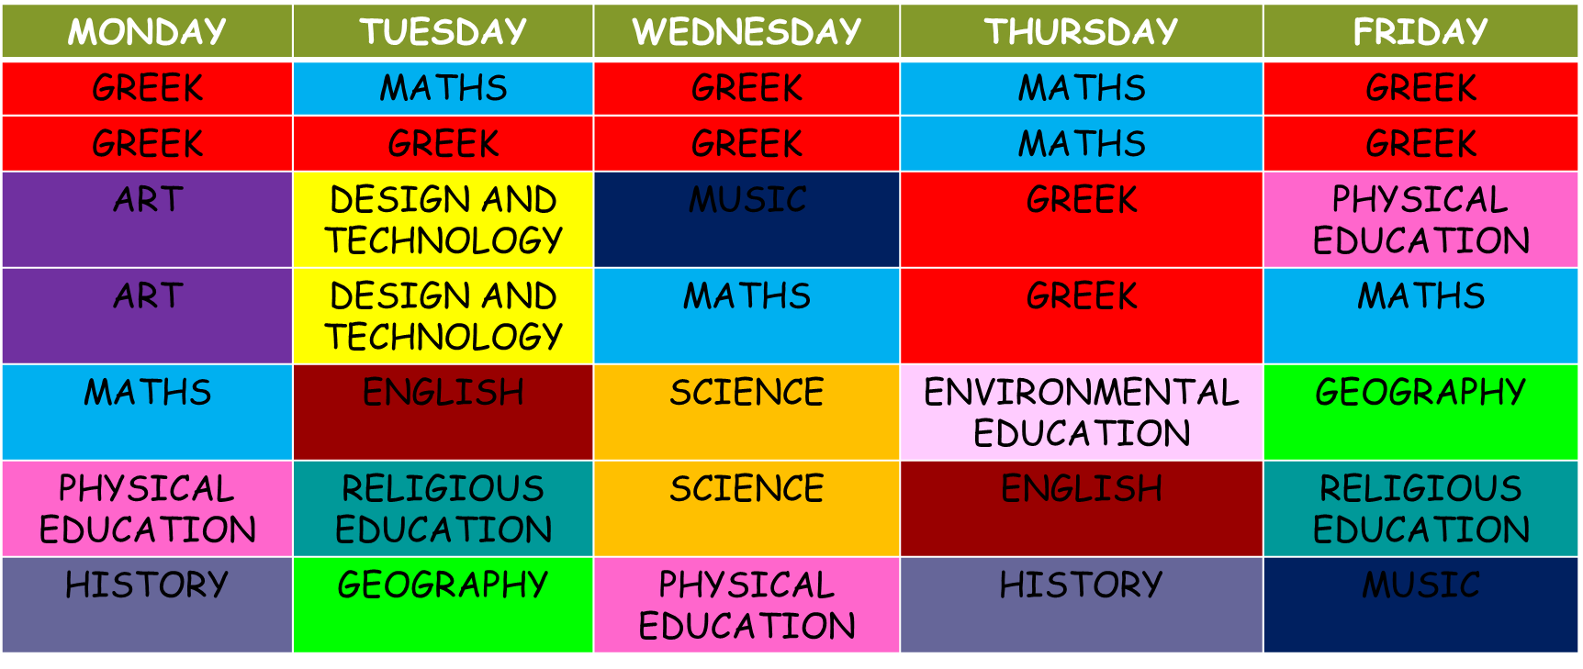
How often does Minas have Art?
a. Once a week
b. Twice a week
c. Three times a week

Slide 19


Slide 20


Slide 21
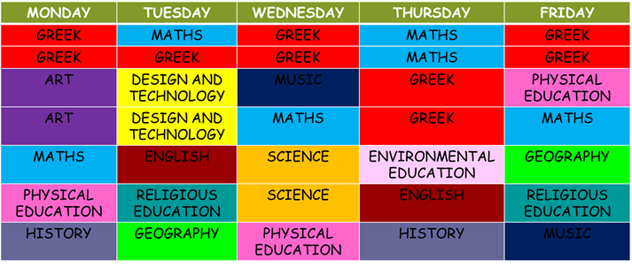
How often does Minas have Greek?
a. Once a week
b. Twice a week
c. Five times a week

Slide 24
How often does he have History?
a. Once a week
b. Twice a week
c. Three times a week

Slide 27
How often does he have Science?
a. Once a week
b. Twice a week
c. Three times a week

Slide 30
How often does he have English?
a. Once a week
b. Twice a week
c. Three times a week

Slide 33
How often does he have Maths?
a. Once a week
b. Twice a week
c. Five times a week

Slide 36
Now put the words in the right order and make sentences!
https://wordwall.net/resource/1434961/routines

Slide 37


Let’s meet Chloe’s e-pal!

Slide 38


Hi! I’m Paula. I’m Italian. I live in Rome.
Every day I get up at half past seven. I usually have cereal for breakfast. I go to school at quarter to nine and lessons start at nine o’clock. I have Italian, English and Maths four times a week. I love Maths. I have Science every Monday and Wednesday. I don’t like Science very much. I have Geography every Tuesday and Wednesday. I like my Geography teacher! She is very interesting. I also have a computer lesson twice a week. I have Music every Monday. I play the piano. I love playing the piano.

Slide 39
Let’s check your memory!
Do the following quiz!
Good luck!
https://www.quia.com/quiz/7699969.html

Slide 40
Images courtesy of:
https://wikiclipart.com
Presentation designed by the English Curriculum Development team,
Cyprus Ministry of Education, Culture, Sport and Youth

