Slide 1
Clothes!

Slide 2
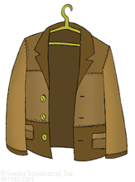
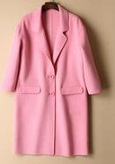
Look, Listen and Repeat.
jacket
coat
Did you know? Trousers are also called pants (American English)

Slide 3
Now let’s play!
Click below and find the clothes.
https://learnenglishkids.britishcouncil.org/word-games/clothes-1
Click below and play a memory game.
https://www.eslgamesplus.com/clothes-vocabulary-esl-memory-game/

Slide 4
Look at the clothes again and try to remember their colours. Then click below to play a memory game.
http://www.quia.com/quiz/7686743.html
jacket
coat

Slide 5
Let’s play more.
1. Click below and then press START:
https://paf.dias.ac.cy/main/ekpaudeutiko_yliko/dimotiko-agglika-D-E/d17/cd/startup.html
2. Click here: 3. Click here
4. Choose a boy or a girl and help him/her get dressed. Choose a cupboard and write the word in the box.
Tip: If there is a word you don’t know press “X” and choose another word.

Slide 6
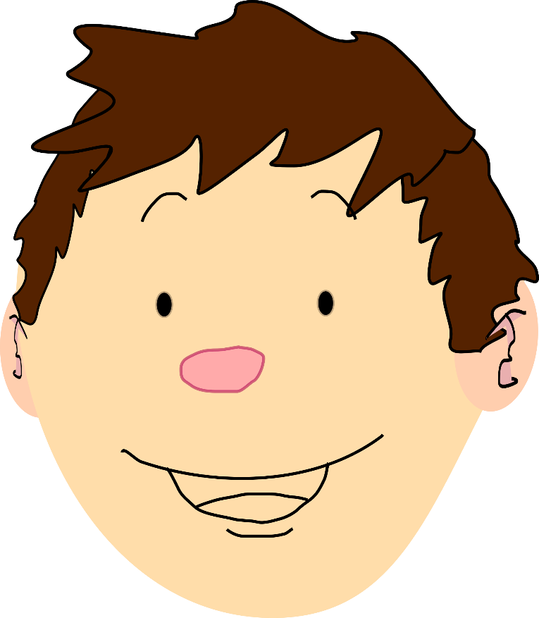
Now, let’s sing!
1. Click below and watch the video.
2. Which clothes did you hear in the song?
https://www.youtube.com/watch?v=1GDFa-nEzlg
jacket
coat

Slide 7
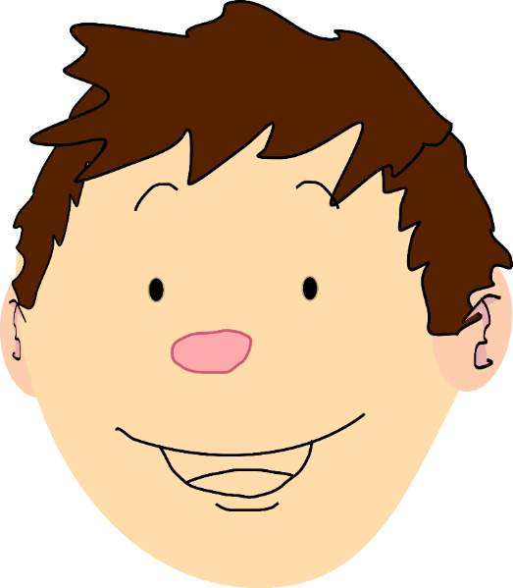
3. Listen to the song again and complete the missing words below. You can write them in your exercise book.
This is the way we put on our ……………., put on our …………….., put on our………….
This is the way we put on our…………………We get dressed every day.
This is the way we put on our ……………., put on our …………….., put on our………….
This is the way we put on our…………………We get dressed every day.
This is the way we button our ……………., button our …………….., button our………….
This is the way we button on our…………………We get dressed every day.
This is the way we put on our ……………., put on our …………….., put on our………….
This is the way we put on our…………………We get dressed every day.
This is the way we tie our ……………., tie our …………….., tie our………….
This is the way tie our…………………We get dressed every day.
This is the way we zip up our ……………., zip up our …………….., zip up our………….
This is the way we zip up our…………………We get dressed every day.
Tip: You can have the song playing and then open your Power Point again so that you can see this page while listening to the song.

Slide 8
4. Make your own song! Complete the lyrics below:
This is the way we put on our…….., put on our……., put on our……..
This is the way we put on our……….. We get dressed every day.

Slide 9
5. Can you record your song? Ask your parents to help you. You can open a Power Point Presentation and do the following: 5
1. In the Power Point presentation click “Insert”
2. Click “Audio” and then “Record Audio”
3. You will see this
4. Write your name and press
5. Start speaking.

Slide 10
Another idea!
You can record yourself singing the song using your parents’ mobile phone!
Then your parents can help you to send it to your teacher!

Slide 11
Read the following:
This is Kyriacos. He is wearing a blue
t-shirt, grey trousers and sunglasses.
This is Liu. She is wearing a blue dress and white sandals.
Let’s play a game! Click below and match the pictures with the sentences.
http://www.quia.com/jg/3120112.html

Slide 12
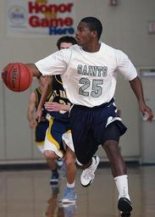
My favourite clothes
Hi! I’m Salena. I’m from India. I love dancing! Today I’m wearing a dress. It’s my favourite. It’s red and it’s very long.
Hi! I’m Ken. I’m from the USA. I love playing basketball! Today I’m wearing a white t-shirt, blue shorts and white shoes. They are my favourite clothes.
What are their favourite clothes?
Write a paragraph about you and your favourite clothes.

Slide 13
Let’s make a poster!
Wear your favourite clothes (ask your parents first!) and ask someone to take a picture of you.
OR
Draw yourself wearing your favourite clothes.
Stick your photo or your picture on a piece of paper and write a small paragraph like Salena and Ken.
Ask for your teacher’s email and send a picture of your poster.

Slide 15
Images courtesy of:
https://free-images.com/
Presentation designed by the English Curriculum Development team,
Cyprus Ministry of Education, Culture, Sport and Youth

