Slide 1

IN THIS LESSON I WILL:
Learn the names of different fruit and animals
Play vocabulary games
Remember the English alphabet
Sing a song
Watch my favourite story “Handa’s surprise”
Make a drawing
This Photo by Unknown Author is licensed under CC BY

Slide 2

LET’S START WITH A SONG TO REMEMBER THE ALPHABET!!!
Listen and sing along : https://www.youtube.com/watch?v=BELlZKpi1Zs
This Photo by Unknown Author is licensed under CC BY

Slide 3
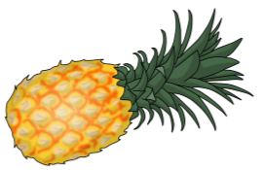
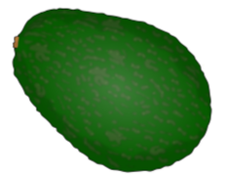
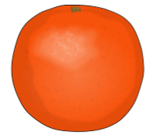
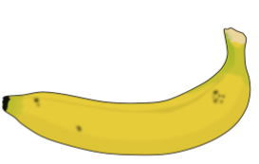





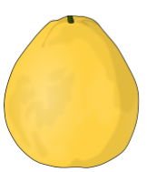
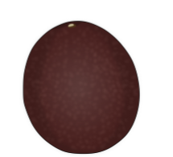
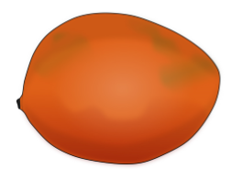
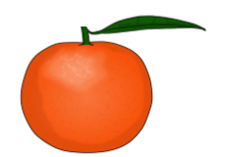




Fruit
Look, listen and say

Slide 4
Fruit
Let’s play…
What’s missing?

Slide 5
Fruit

Slide 6
Fruit

Slide 7
Fruit

Slide 8
Fruit

Slide 9
Fruit

Slide 10
Fruit

Slide 11
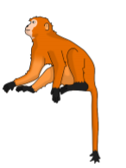
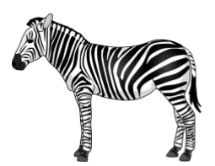
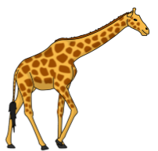
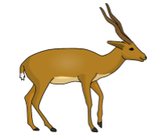




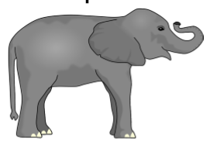
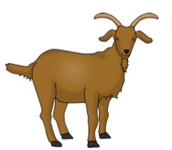
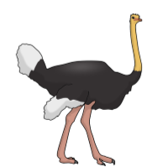
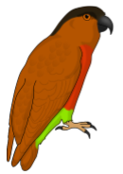




Look, listen and say
Animals

Slide 12
Let’s play some games with fruit and animals.
https://wordwall.net/resource/623006
This Photo by Unknown Author is licensed under CC BY

Slide 13
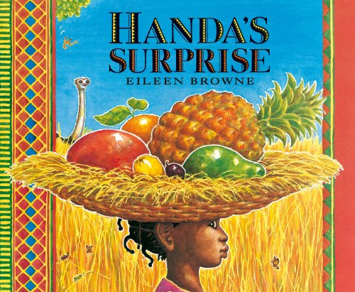
Storytime!
Do you remember Handa?
Listen to the story one more time by clicking the link below:
https://www.youtube.com/watch?v=XyIV_xYi0as

Slide 14


LET’S BE CREATIVE…
Draw your fruit in your basket.
What fruit have you got?
I’ve got a mango.
I’ve got two bananas.

Slide 15
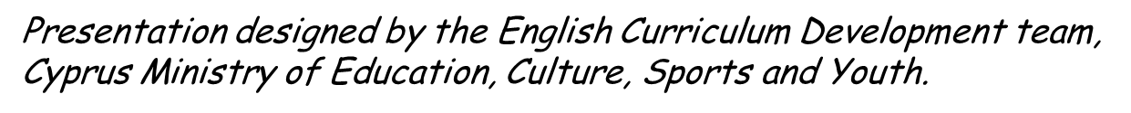
IMAGES COURTESY OF :
https://www.sparklebox.co.uk
https://www.memrise.com/

