Slide 1
My body

Slide 2
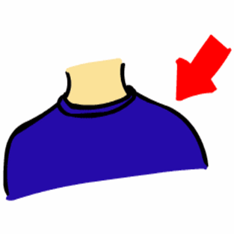
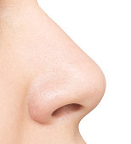
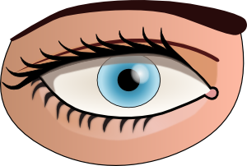
Listen, point and say

Slide 3
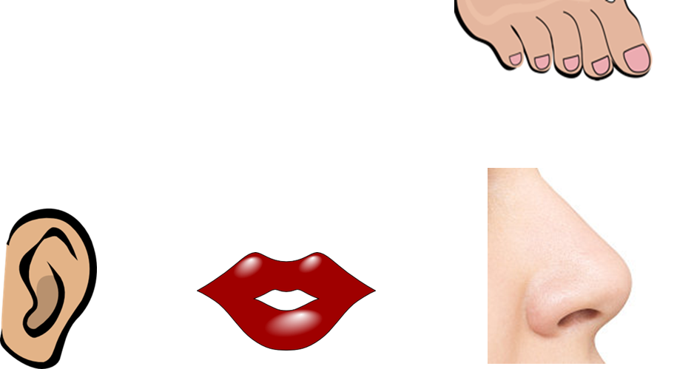
What’s missing?

Slide 5
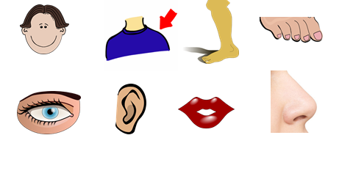

Slide 6
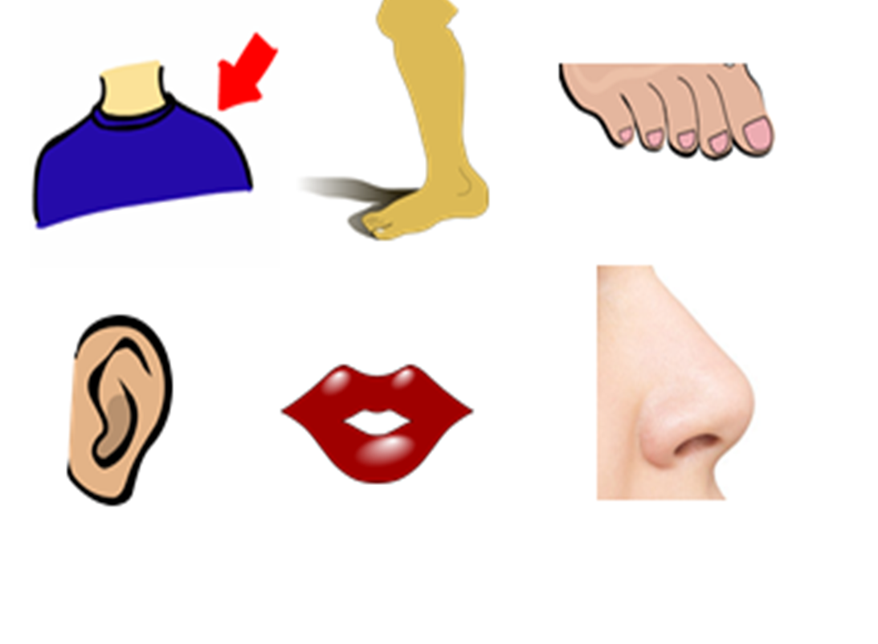
What’s missing?

Slide 8
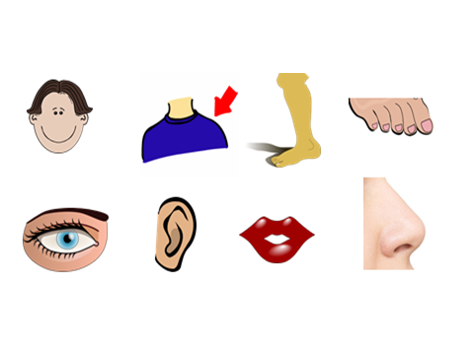

Slide 9
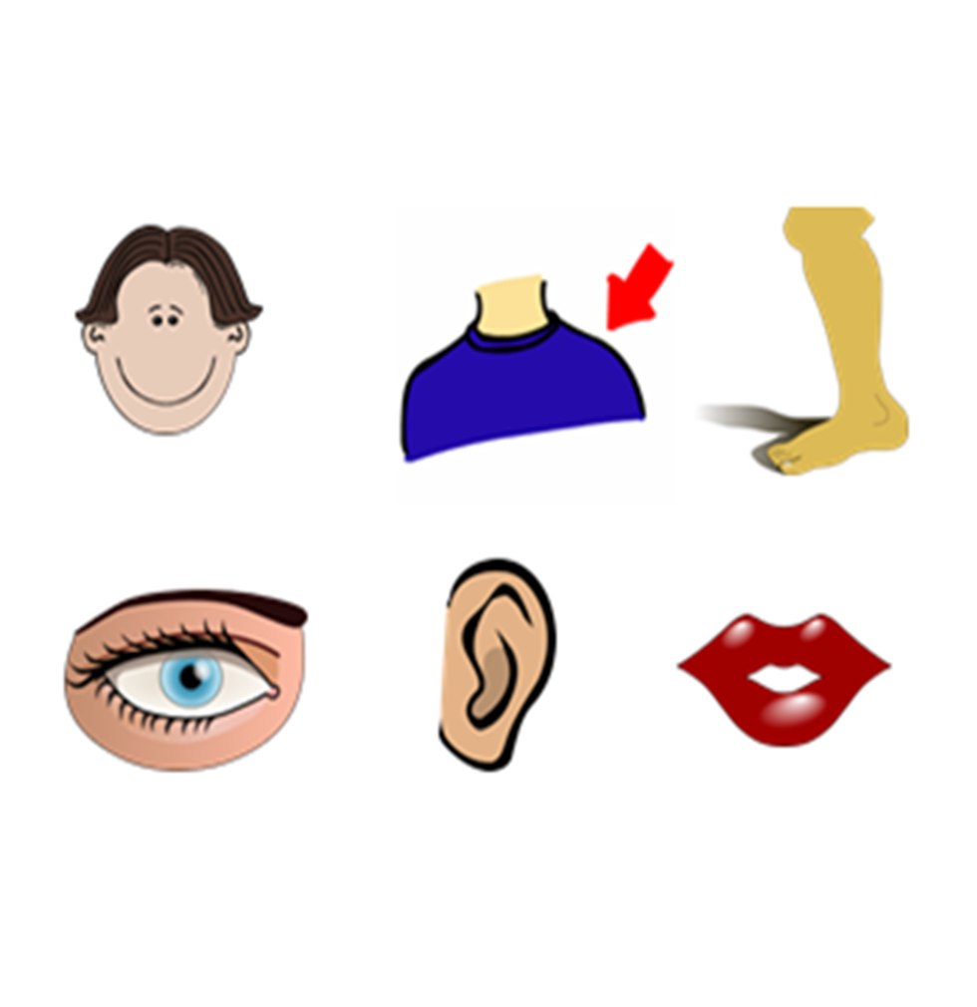
What’s missing?

Slide 12
What’s missing?

Slide 15
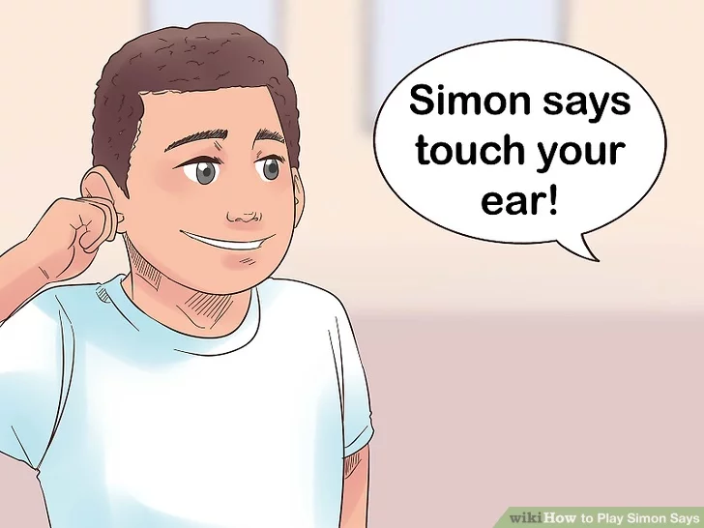
Let’s play ‘’Simon says…’’

Slide 16
Let’s play a memory game!
http://www.quia.com/jg/3117194.html

Slide 17
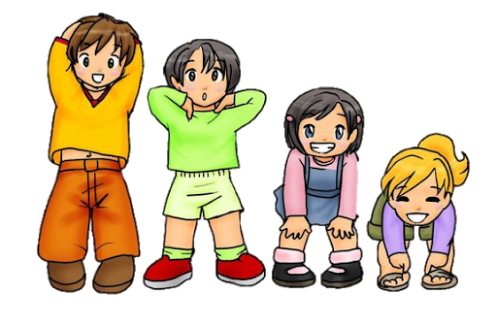
Let’s sing ‘’Head and shoulders, knees and toes!”
https://www.youtube.com/watch?v=ZanHgPprl-0

Slide 18
Creative exercise

Slide 19
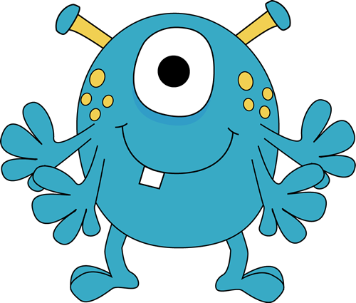
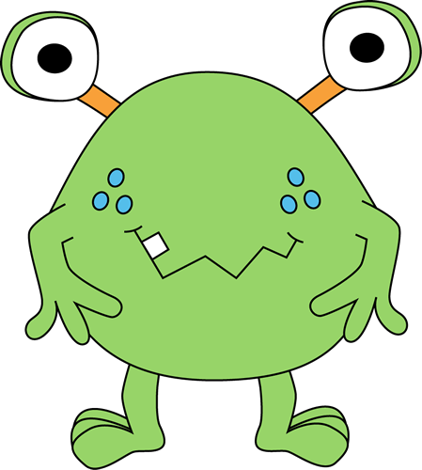
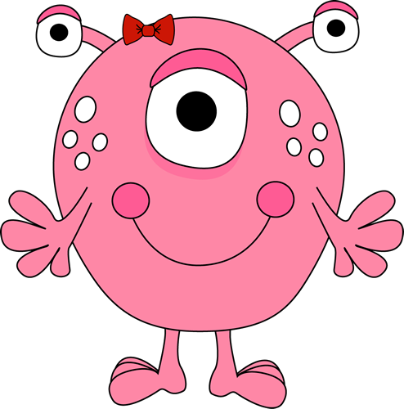
Listen and click on the right monster.

Slide 22
Well done!

Slide 23
http://www.clker.com
https://images.app.goo.gl/rdPYg7tRaJNjFsMg7
https://images.app.goo.gl/8Bfx5i28yNBJR3s18

