Slide 1
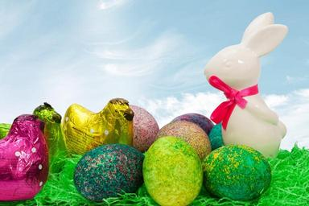
ACTIVITIES FOR EASTER HOLIDAYS Αγαπητά μου παιδιά, σας στέλνω κάποιες ευχάριστες δραστηριότητες που μπορείτε να κάνετε κατά τη διάρκεια των διακοπών του Πάσχα, όπως παιχνίδια, ζωγραφική και άλλα. Ελπίζω να σας αρέσουν. Μαζί, σας στέλνω τις ευχές μου και μια πασχαλινή κάρτα: https://www.123cards.com/easter-ecards/juggler/ with love and best wishes Irene Temete
Happy Easter

Slide 2
Find the words
https://learnenglishkids.britishcouncil.org/word-games/easter
Find the eggs
https://www.primarygames.com/holidays/easter/games/egg_hunt/
How fast can you count? Count the Easter Bunnies.
https://games4esl.com/esl-classroom-games/easter-game-for-kids/
Do the puzzle
https://www.primarygames.com/holidays/easter/games/dragdrop/
Do the crossword
https://www.primarygames.com/holidays/easter/games/eastercrosswordpuzzle/

Slide 3
Listen to the song
https://www.youtube.com/watch?v=5pU8vycGwfY
Do the worksheet
https://learnenglishkids.britishcouncil.org/sites/kids/files/attachment/worksheets-easter.pdf
And here are the answers:
https://learnenglishkids.britishcouncil.org/sites/kids/files/attachment/worksheets-easter-answers.pdf

Slide 4
Let’s read about Easter (for years 5 and 6)
Read about Easter
https://www.topmarks.co.uk/Easter/
Read about the story of Jesus Christ
https://www.topmarks.co.uk/Easter/EasterStory.aspx
Read about Easter Eggs
https://www.topmarks.co.uk/Easter/EasterEggs.aspx
Read about the Easter Bunny
https://www.topmarks.co.uk/Easter/EasterBunny.aspx

Slide 5
Take your coloured pencils, make an Easter card and write “ HAPPY EASTER”

Slide 6
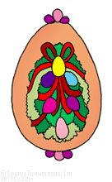
HAPPY EASTER
Many thanks to my colleague Dia Germanou for sending me some of the activities!

