Slide 1
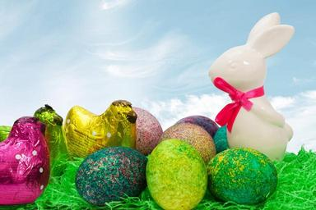
ACTIVITIES FOR EASTER HOLIDAYS Αγαπητά μου παιδιά, σας στέλνω κάποιες ευχάριστες δραστηριότητες που μπορείτε να κάνετε κατά τη διάρκεια των διακοπών του Πάσχα, όπως παιχνίδια, ζωγραφική και άλλα. Ελπίζω να σας αρέσουν. Μαζί, σας στέλνω τις ευχές μου και μια πασχαλινή κάρτα: https://www.123cards.com/easter-ecards/juggler/ with love and best wishes Irene Temete
Happy Easter

Slide 2
Colour the easter egg
https://www.primarygames.com/holidays/easter/games/eastereggscoloring/ (for years 1, 2, 3)
Find the words
https://learnenglishkids.britishcouncil.org/word-games/easter (for year 3)
Find the eggs
https://www.primarygames.com/holidays/easter/games/egg_hunt/ (for years 1, 2, 3)
Do the puzzle
https://www.primarygames.com/holidays/easter/games/dragdrop/ (for years 1, 2 , 3)
Do the crossword
https://www.primarygames.com/holidays/easter/games/eastercrosswordpuzzle/ (for year 3)

Slide 3
How fast can you count? Count the Easter Bunnies.
https://games4esl.com/esl-classroom-games/easter-game-for-kids/ (for years 1, 2, 3)
Listen to the song
https://www.youtube.com/watch?v=5pU8vycGwfY (for years 1, 2, 3)
Print the pictures and colour them
https://www.topmarks.co.uk/Easter/EasterColourings.aspx (for years 1, 2, 3)
Do the worksheet
https://learnenglishkids.britishcouncil.org/sites/kids/files/attachment/worksheets-easter.pdf (for year 3)
And here are the answers:
https://learnenglishkids.britishcouncil.org/sites/kids/files/attachment/worksheets-easter-answers.pdf

Slide 4
Take your coloured pencils, make an Easter card and write “ HAPPY EASTER”

Slide 5
HAPPY EASTER
Many thanks to my colleague Dia Germanou for sending me some of the activities!

